Slide 1
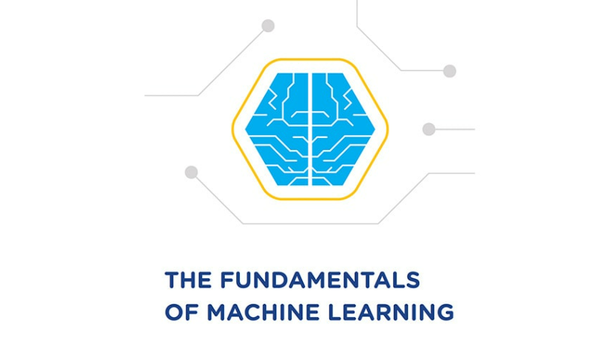

FUNDAMENTALS OF MACHINE LEARNING
FINAL PROJECT
DONE BY:
RAMIREDDY MEGHANA REDDY

Slide 2
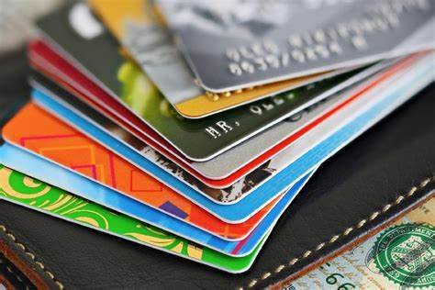
ABOUT THE DATASET & PROBLEM
To outline the marketing plan in this scenario, a consumer segmentation must be created. About 9000 active credit card users' usage patterns during the last six months are summarized in the sample dataset. The file contains 18 behavioral characteristics at the consumer level

Slide 3
Hierarchical Clustering
K MEANS
DBSCAN
There are 3 clusters according to the dendogram. It can be stopped at a threshold of 38 because the blue like which is the vertical line with the greastest distance is visible
K Means determines whether 2 objects are similar and clusters
A cluster is shown as the biggest group of closely spaced-apart points.

Slide 4
CONCLUSION
We finalize that K means clustering gives the appropriate results. The results are all appearing in the 7 clusters , we have arranged those 7 clusters based on the features.
The clusters show the study of the customers.
Greatest credit limits purchase more frequently and tend to pay in instalments and given vice verse.
There are people with greatest balance amounts but not the best in terms of purchasing frequency.Those who have higher credit limits tend to pay in cash and dislike making purchases.
All of the analysis is being clearly shown in the clusters.
Hence we consider k-means is the appropriate method to analyse and make up the strategies.

